Slide 1
5 selfish reasons to work reproducibly
More publications, more grants, more awesome!

Slide 2
Systems Genetics of Cancer
Genetic variation
In people
In tumours
In clones
Phenotypic variation
Tumour subtypes
Aggressiveness
Survival

Slide 3
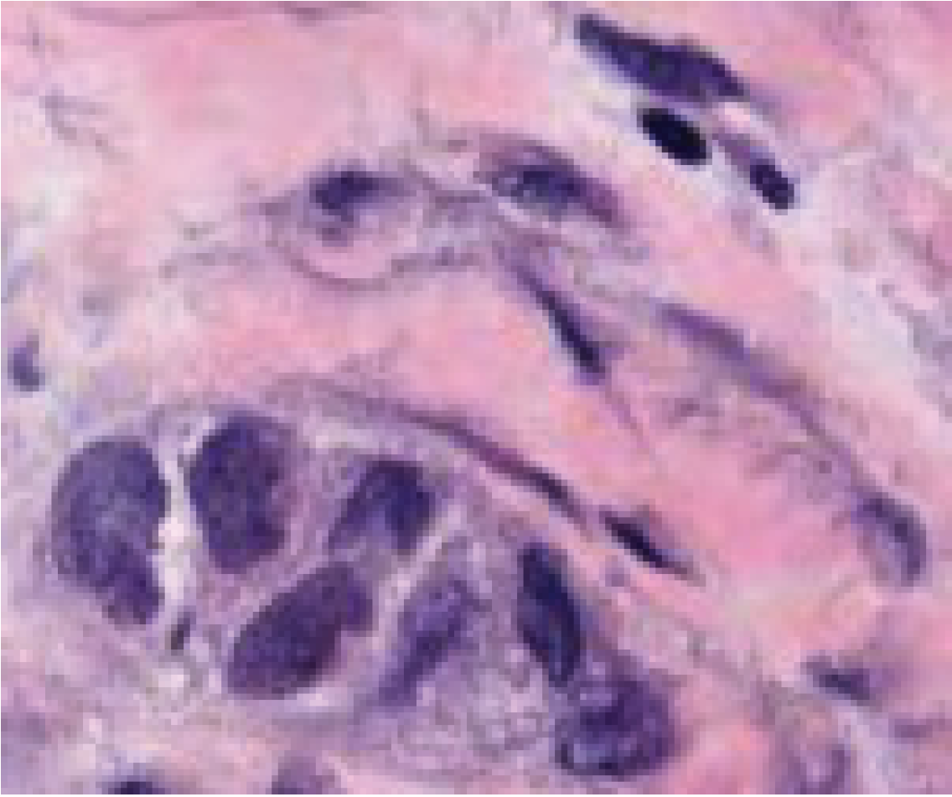
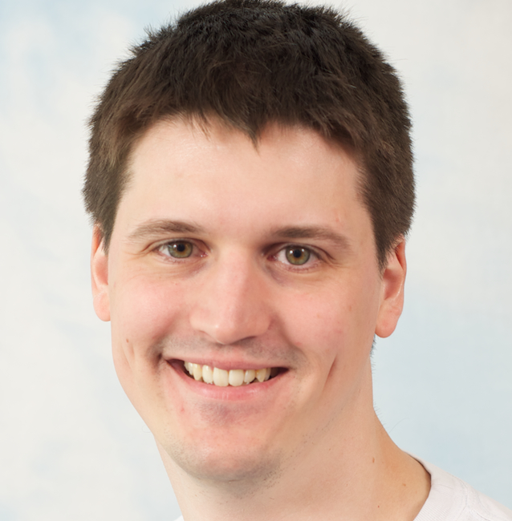
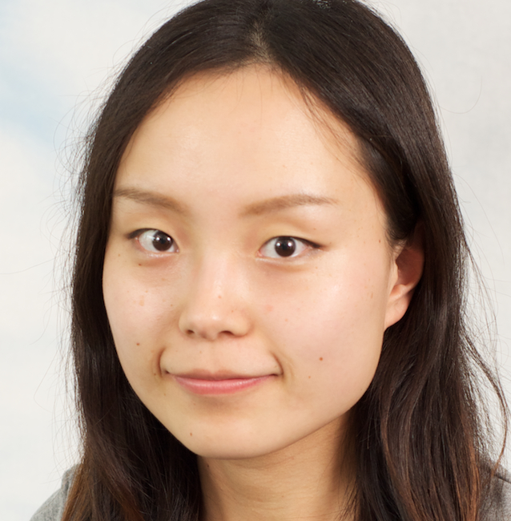
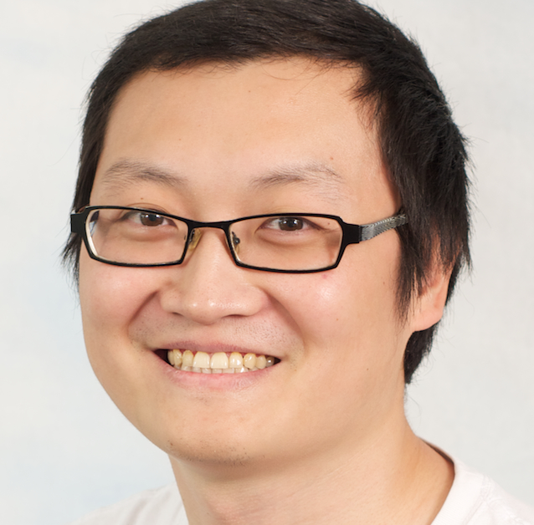
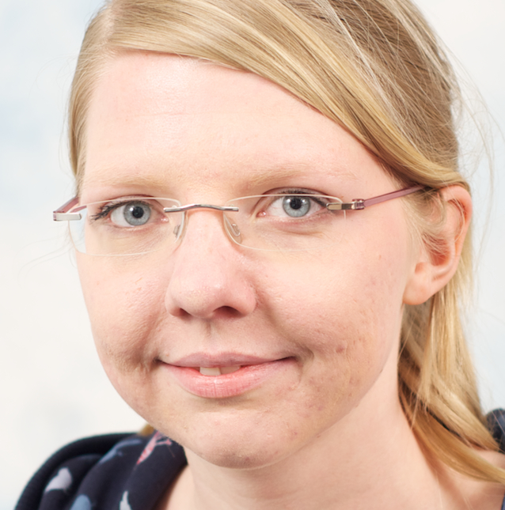
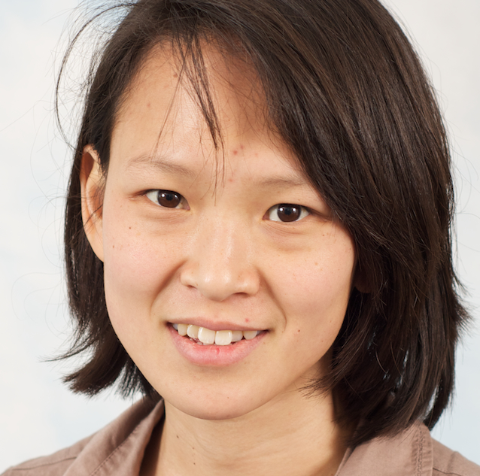
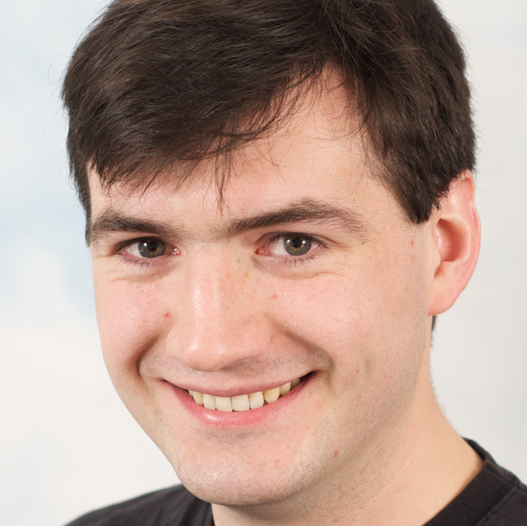
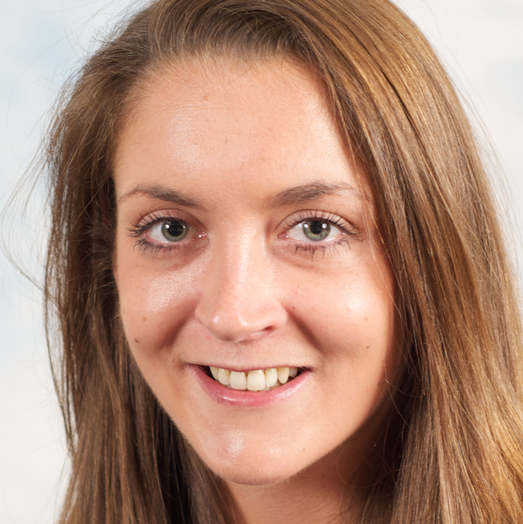
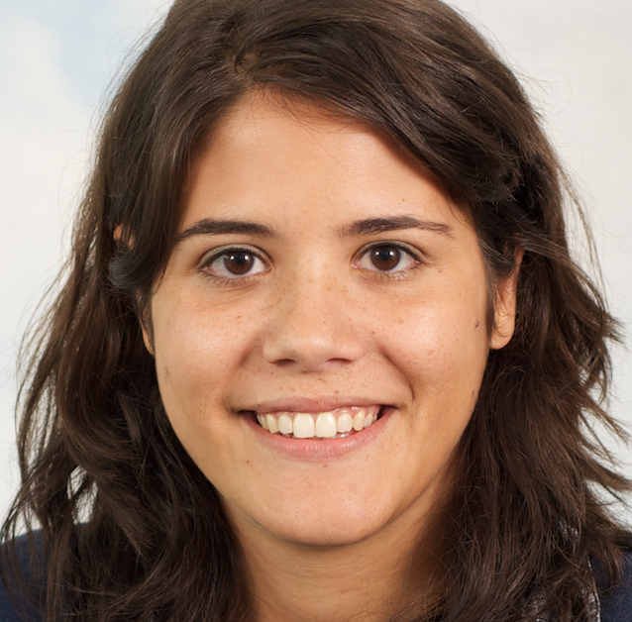
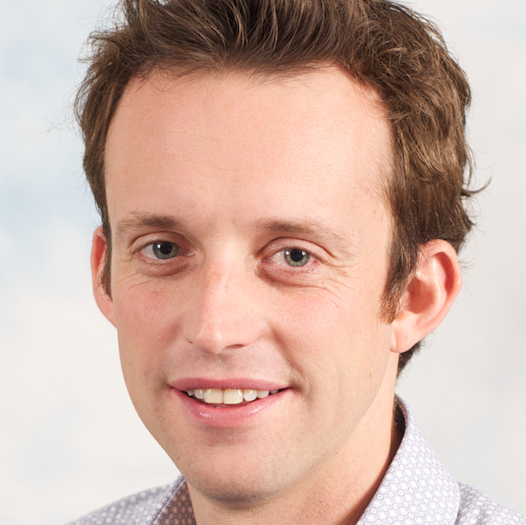
Cancer genome
Function
Cancer genome
Evolution
Cancer tissue
Context
Andy
Wei
Ke
Edith
Anne
Joe
Amanda
Ines
Geoff
Leon

Slide 4
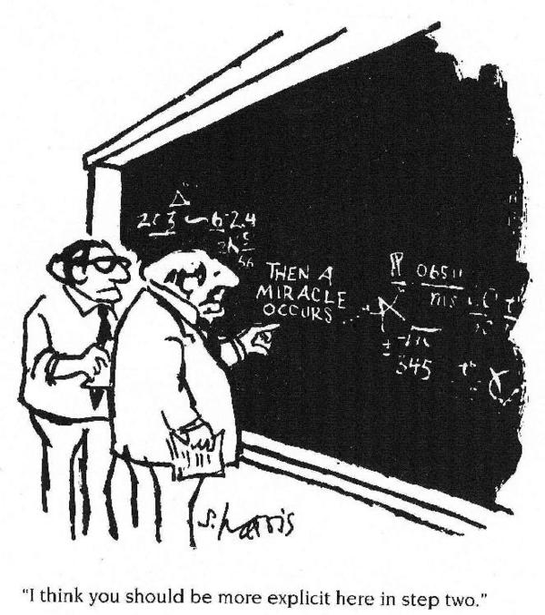
Science ≠ miracles

Slide 5
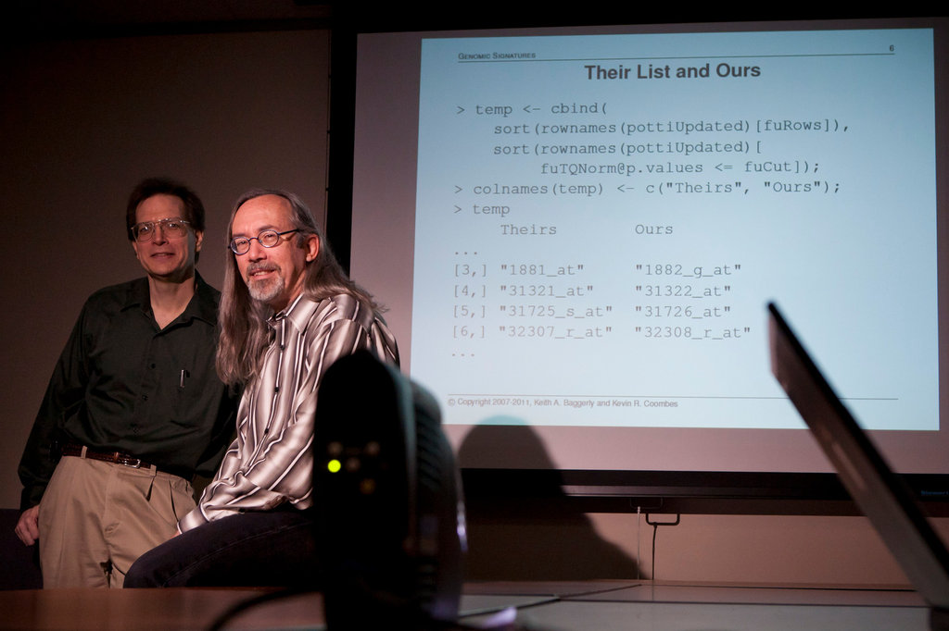
“How Bright Promise in Cancer Testing Fell Apart” New York Times, July 7, 2011

Slide 6
Slides by Keith Baggerly

Slide 7
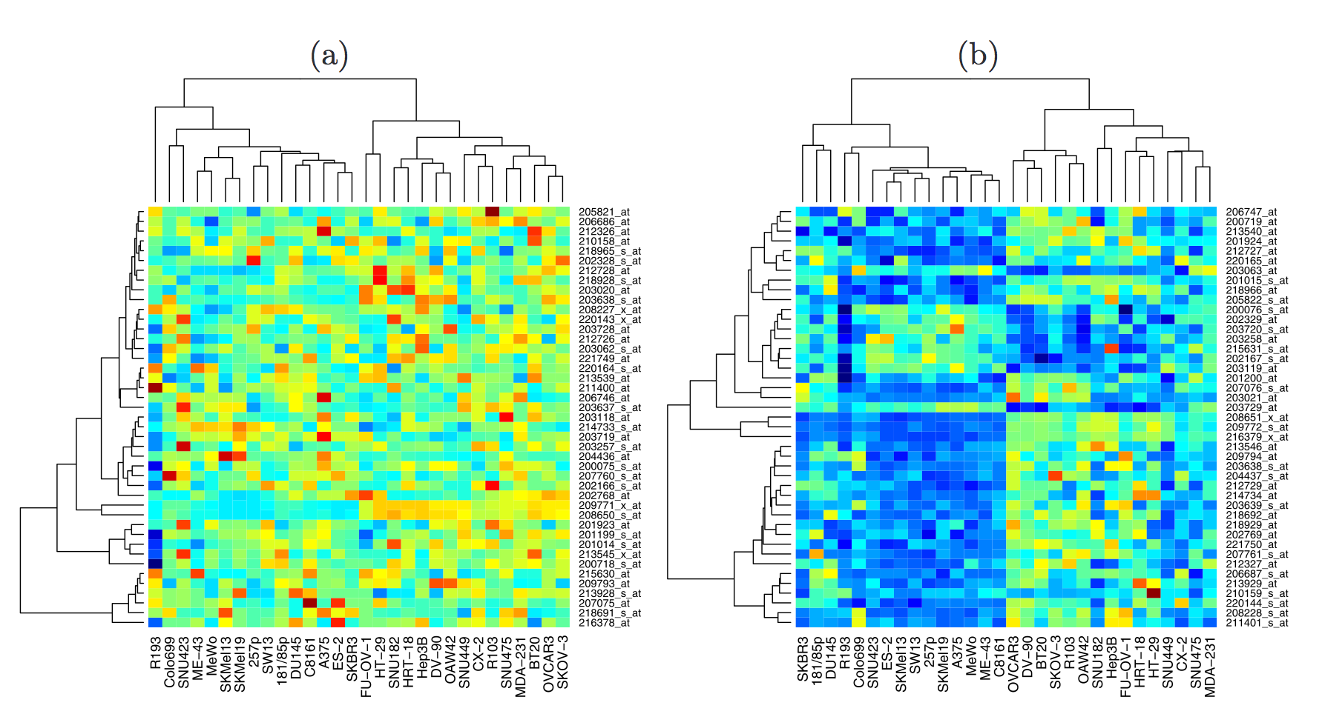
Slides by Keith Baggerly

Slide 8
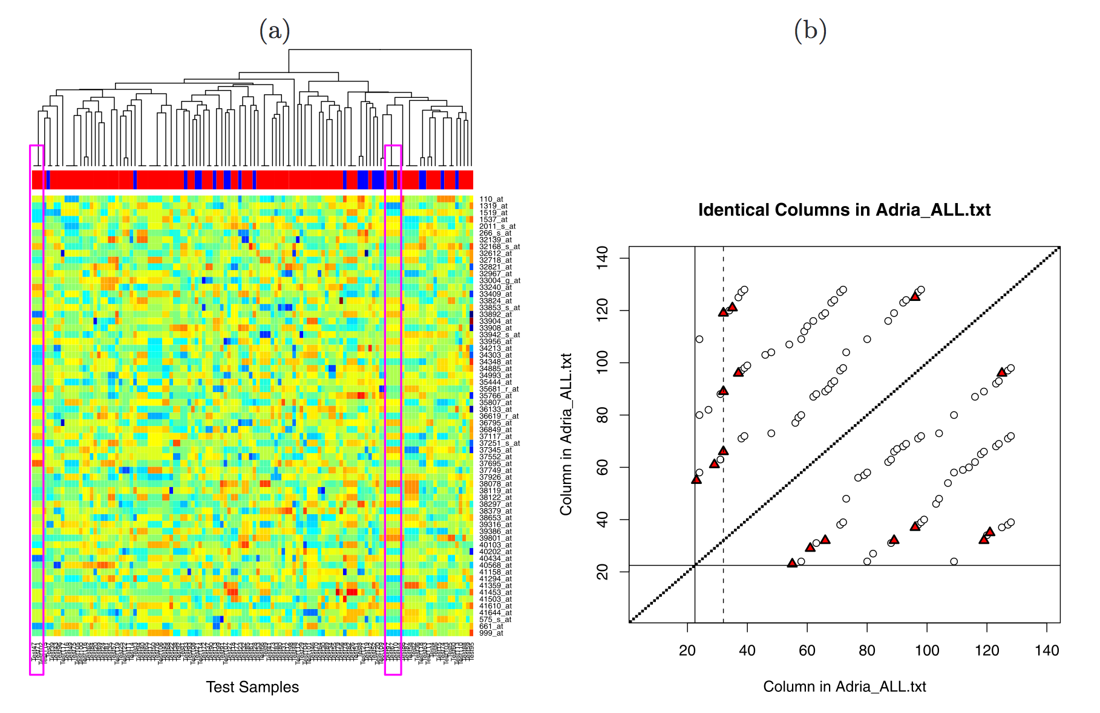
Baggerly & Coombes, AOAS 2009

Slide 9
Slides by Keith Baggerly

Slide 10
http://videolectures.net/cancerbioinformatics2010_baggerly_irrh/

Slide 11
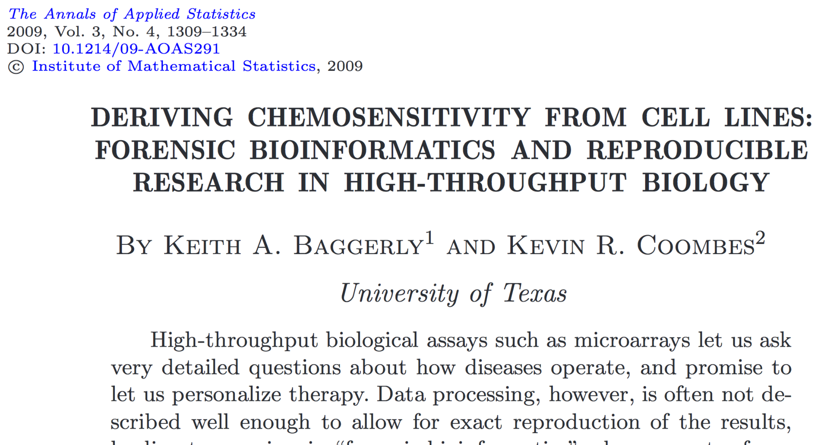

Slide 12
Reproducible Research
0
It’s the right thing to do!
The world would be a better place if everyone did it!
It’s the foundation of Science!
It’s the honourable thing to do!

Slide 13
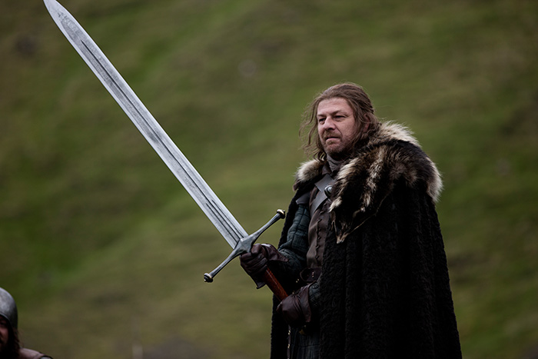

Slide 15
Reproducibility helps to avoid disaster
1

Slide 16
Anatomy of the NFκB pathway
Step 1
?
Hits
Weak
Phenotype
Strong
NFκB
Step 2
Knock-down
Compare
expression
phenotypes
by NEMs
Known pathway
members
New RNAi Hits

Slide 17
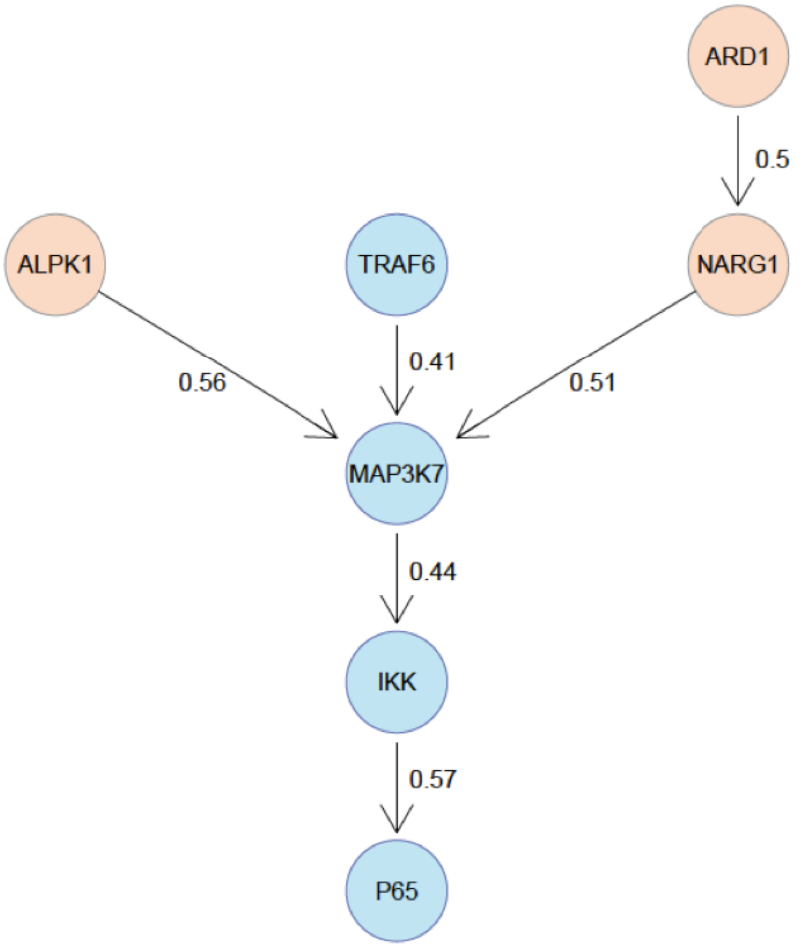
What a nice result!
R.I.P.

Slide 18
A project is more
than a beautiful result!

Slide 19
Starting with
reproducibility early
helps saving time later

Slide 20
Reproducibility helps writing papers
2

Slide 21
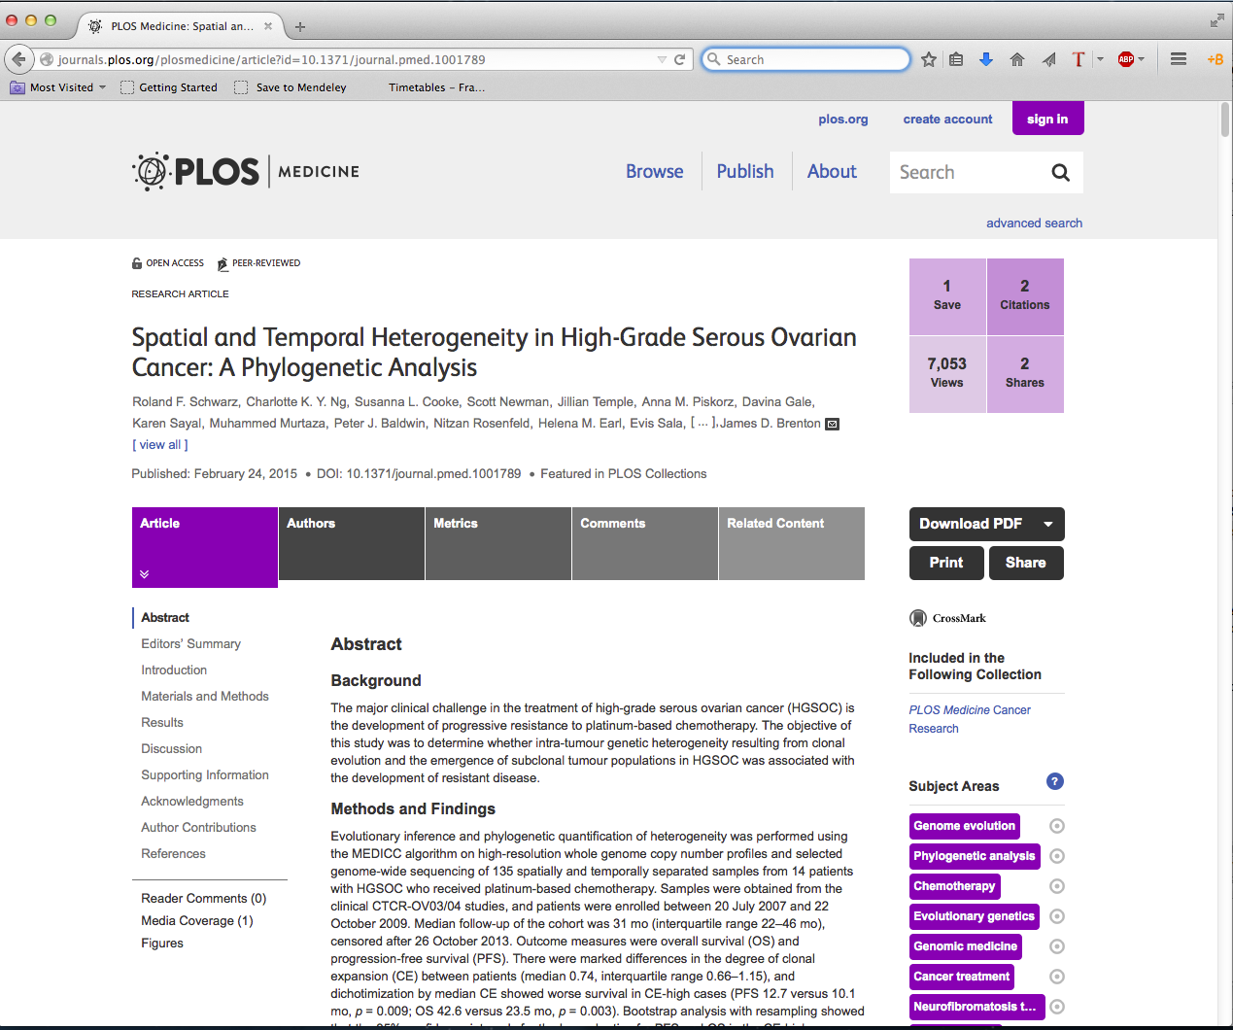

Slide 22
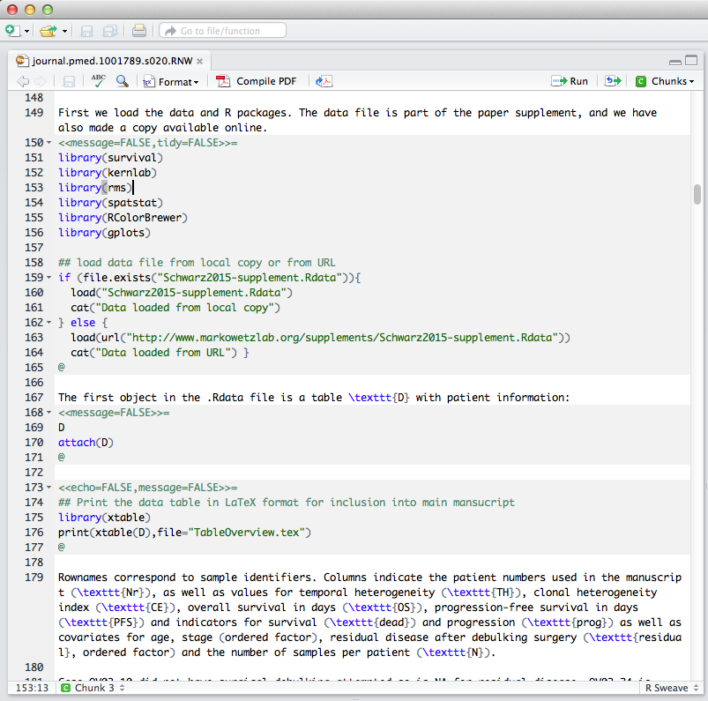
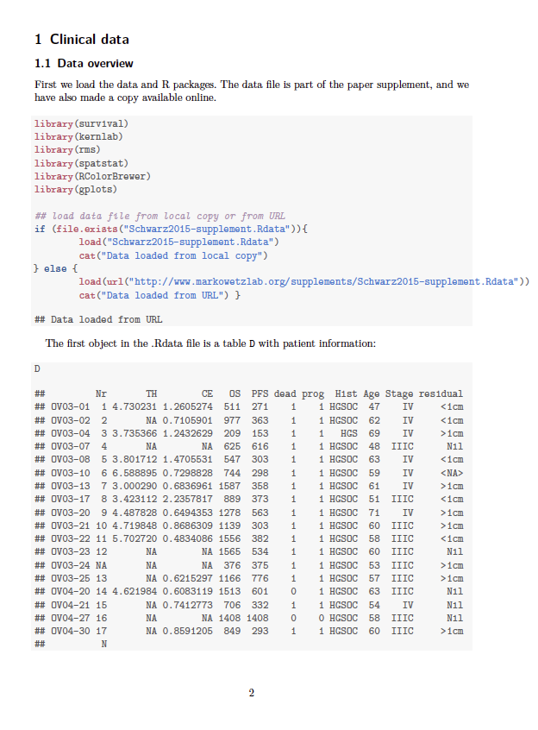

Slide 23
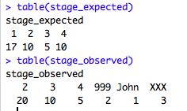
Why is well-documented and easily accessible code+data useful?
Easy to look up numbers and put them in manuscript
Be confident your figures and tables are up-to-date
Numbers and result automatically update when data change.
It is engaging and more eyes can look over the analysis.
Easier to spot mistakes.

Slide 24
Reproducibility helps arguing with reviewers
3

Slide 25
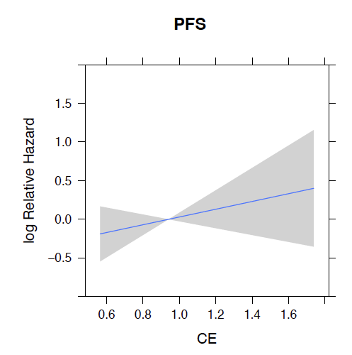
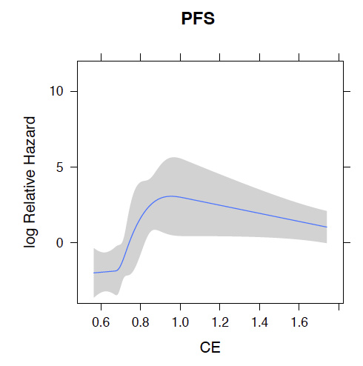
A very engaged reviewer
Reviewer: “I downloaded the authors’ data and tried out a variation of their analysis which gave an insignificant result”
We: “Thank you, the reason is XXX and if you do YYY everything is fine.”

Slide 26
Reproducibility enables continuity
4

Slide 27
“I am so busy,
I can’t remember all the details of all my projects”

Slide 28
“I did this analysis 6 months ago.
Of course I can’t remember all the details any more …”

Slide 29
“My PI said I should continue the project of a previous postdoc.
But that postdoc is long gone and hasn’t saved any scripts or data.”

Slide 30
Reproducibility helps to build your reputation
5

Slide 31
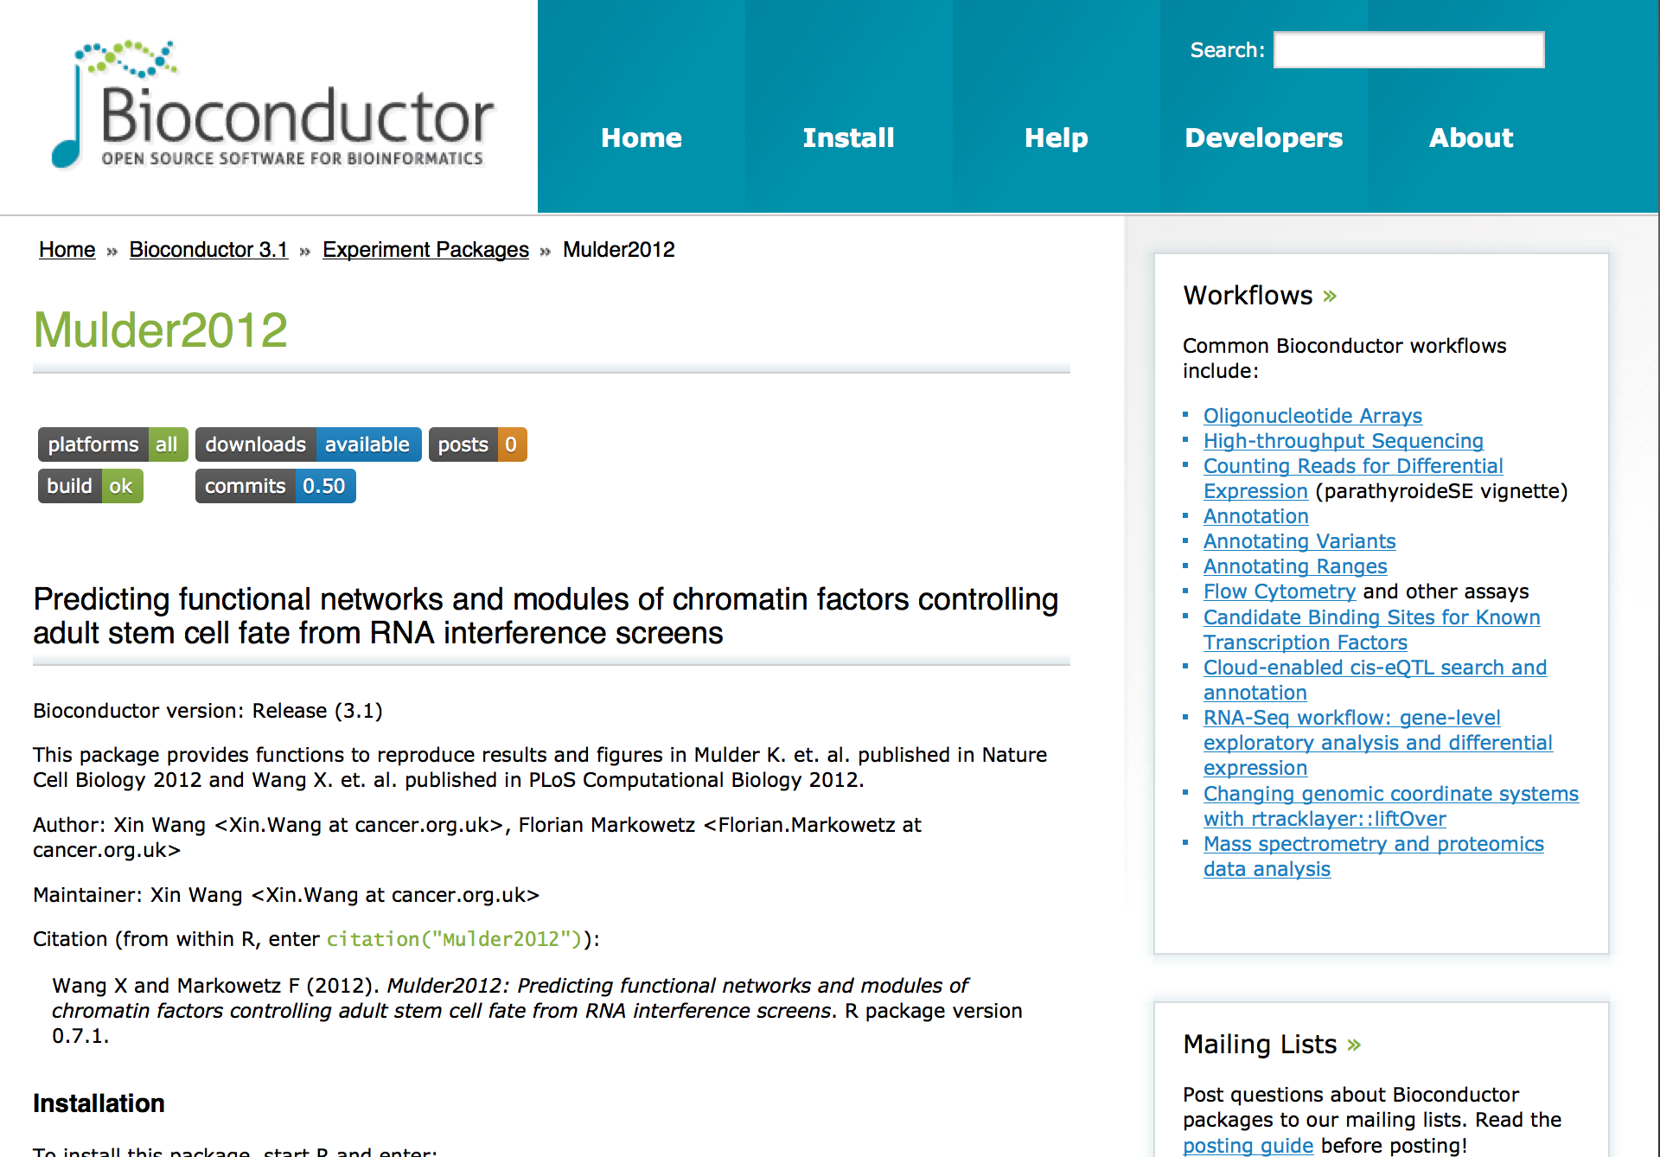

Slide 32
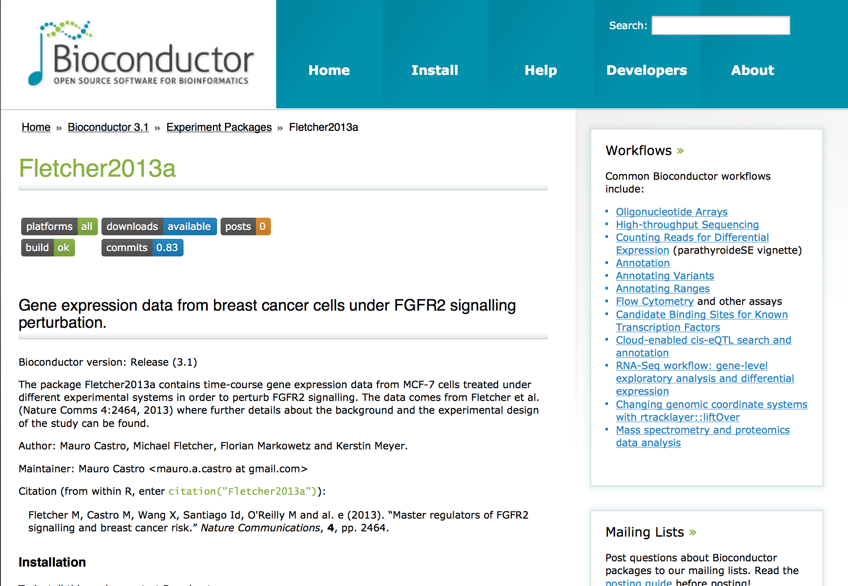

Slide 33
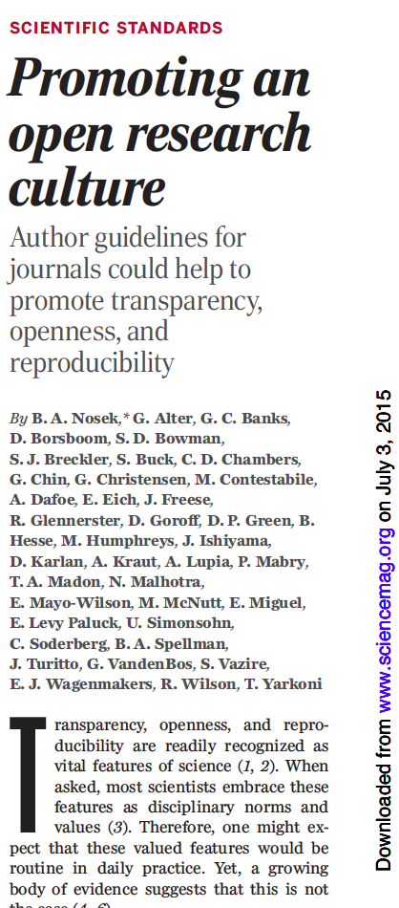
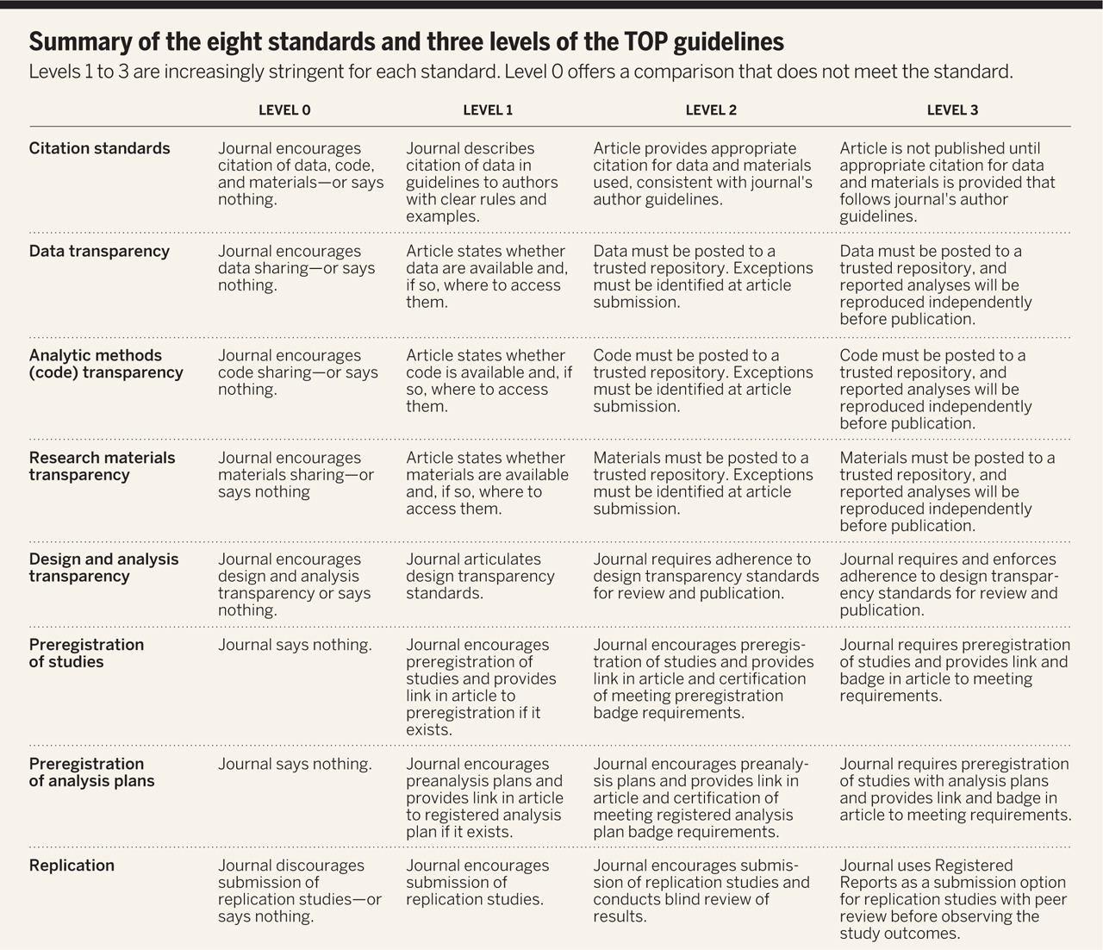

Slide 34
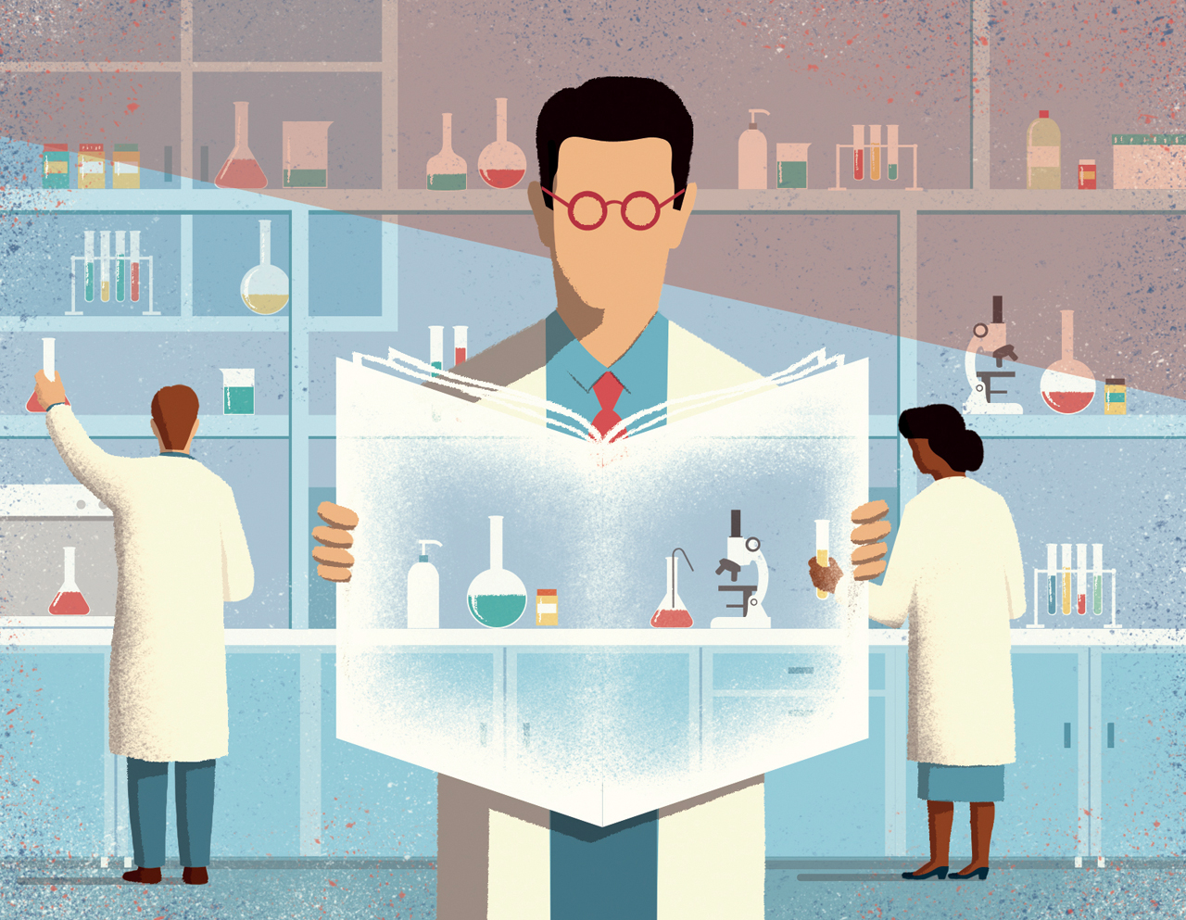
http://www.sciencemag.org/content/348/6242/1422/F1.large.jpg

Slide 35
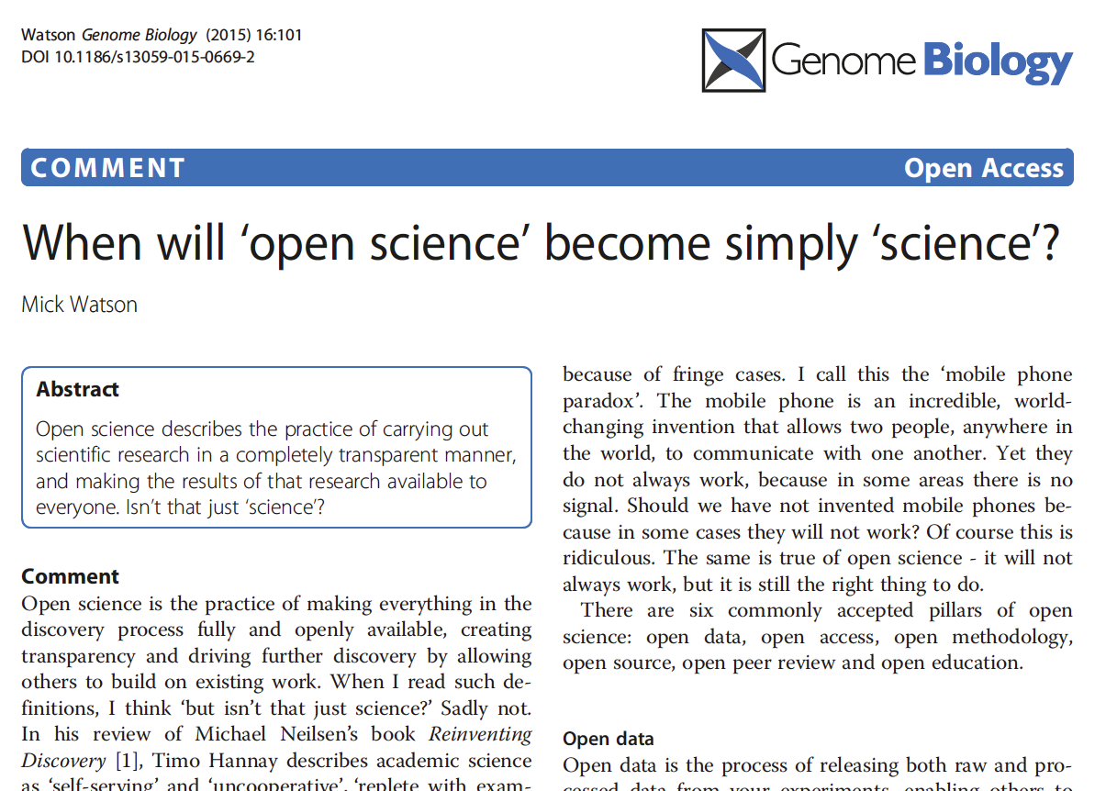

Slide 37
“Mind your own business!
I document my data the way I want!”

Slide 38
“Excel works just fine.
I don’t need any fancy R or Python or whatever.”

Slide 39
“Sounds alright, but my code and data are spread over so many hard drives and directories that it would just be too much work to collect them all in one place”

Slide 40
“My field is very competitive
and I can’t risk wasting time”
Notes:
Think of it as putting in the right experimental controls. Can be time consuming but integral part of project.

Slide 41
“We can always sort out the code and data
after submission”

Slide 42
“It’s only the result that matters!”

Slide 43
“I’d rather do
real science
than tidy up
my data”

Slide 44
5 selfish reasons to work reproducibly
Avoid disaster
Easier to write papers
Easier to talk to reviewers
Continuity of your work/in the lab
Reputation

Slide 45
When do you need to worry about reproducibility?
Before you start the project
While you do the analysis
When you write the paper
When you co-author a paper
When you review a paper
ALWAYS!

Slide 46
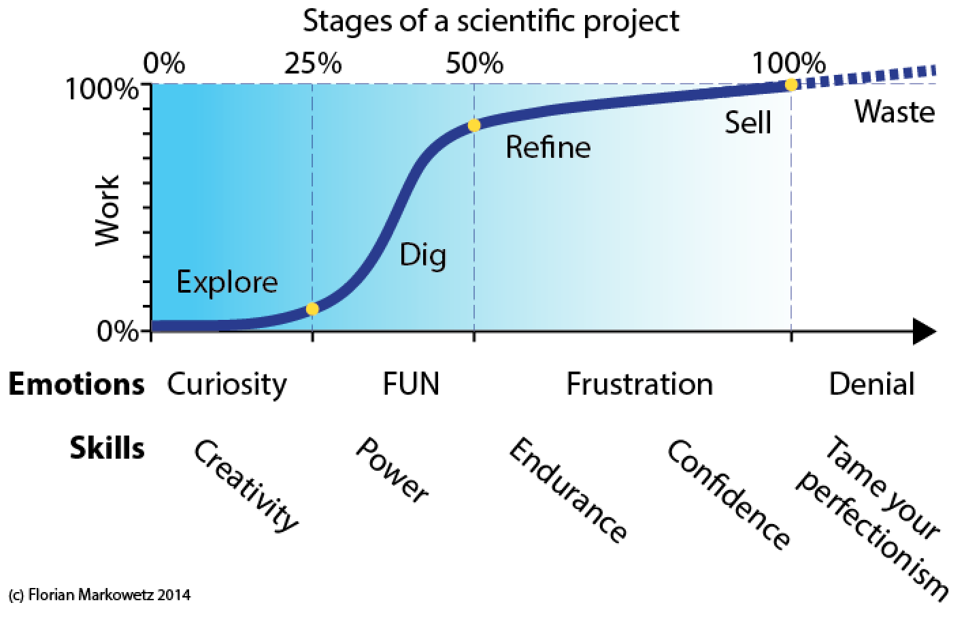
https://scientificbsides.wordpress.com/2014/05/26/methods-vs-insights-4-the-four-stages-of-a-project-and-the-fifth-you-should-avoid/

Slide 47
Scientific SOFT SKILLS
\project
\data
\code
\analysis
\paper
Organization of project
Tidy data
Tidy code
Control over tools
Documentation
Reproducibility
Less clicking and pasting,
more scripting and coding

Slide 48
Reproducibility is important for
Phd students
Postdocs
PIs
Learn tools and apply in daily work!
Create a ‘culture of reproducibility’ in your lab!

Slide 49
5 selfish reasons to work reproducibly
Avoid disaster
Easier to write papers
Easier to talk to reviewers
Continuity of your work/in the lab
Reputation

Slide 50
Next speaker:
Gordon Brown (CRUK CI)
Tools for Computational Reproducibility
Lowering the Cost of Reproducibility

Slide 51
Postdoc Master Class on Reproducibility
The current speaker
Gordon Brown
Stephen Eglen
Wednesday 08 July 2015, 18:30-20:00
Gurdon Institute Tea Room

